Slide 1
Real change is a collective effort: advancing the wellbeing of children and families in the ACT
Children and Family Services Reform Forum
29 March 2021

Slide 2
Acknowledgement
The ACT Government acknowledges the Ngunnawal people as traditional custodians of the Canberra region and acknowledges that the region remains a significant meeting place.
The ACT Government and partners are committed to self-determination as the guiding principle in the delivery of programs and services, and are working in partnership with Aboriginal and Torres Strait Islander communities to address matters that are important to them.

Slide 3
TABLE OF CONTENTS
INTRODUCTION
  Child wellbeing is everybody’s business
ACT REFORMS IN CHILDREN AND FAMILIES SERVICES
  The challenge of the current service system – its focus on tertiary and crisis services
  The current state in ACT children and family services and what needs to change
  The current reform landscape
  A body of work to implement agreed recommendations
Participants are asked to consider the following four key questions when engaging with the paper, as these will be the focus of the Forum discussion:
How can government and community sector work together differently to achieve the reforms? What, from your perspective, is the area we should focus on right now?
How can we bring in the voices and expertise of children, young people and their families into implementation of the reforms?
What can your organisation do differently to achieve the reform agenda and improve outcomes for children? Where in the sector do we need a more joined up approach?
What governance or implementation oversight mechanisms could be established to help drive joint implementation of the reform agenda? Where and how can your organisation be involved?

Slide 4
Introduction
The ACT Government is progressing ambitious and transformative reforms across the child and families services sector. These are aimed at reshaping the service system, improving service design, delivery and practice, and improving outcomes for children and families.
The reforms are built on evidence about how children and young people are doing in the ACT. They are also informed and shaped by extensive consultation with families, the community sector and government stakeholders, all of whom have told us what needs to change to improve wellbeing for children and families.
Setting up children and families for improved longer-term health and wellbeing requires joined up effort from both government and community partners, because it requires systemic change, not just programmatic responses. Simply adding new programs to the existing system will not drive the long-term change we need.
The Child and Families Services Reform Forum is an opportunity for participants to consider how government and its community partners can work together, and collaborate differently, to achieve this agenda and support strong outcomes for children and families.

Slide 5
Child Wellbeing is Everybody’s Business
Families experience wellbeing when they are strong, safe and connected. The ACT Government is committed to improving how families are assisted to be well and to stay together. Child wellbeing is everyone’s business. The government believes that families are the experts in their own lives, but recognises that some families need significant support from time to time, to enable them to live safely and well. Our government and non-government family services rely on us having strong partnerships and effective processes – such as information sharing – to keep children safe. Most families interact with several local service systems on a regular basis, including schools, health services, childcare providers and other community-based services.
We acknowledge there will always be a need for effective child protection systems to work with other services, to make decisions about a small proportion of families who may be unable to reach appropriate decisions themselves to ensure the safety of their children. However, the government also believes that every family should be given the chance, through facilitated and supported meetings, to decide how their family will stay together, fully supported by a joined-up government and non-government service system. The voices of children and young people should also be heard and should inform decision making. There are many jurisdictions with restorative systems in which families have been well supported to change when the prospect of statutory intervention looms.
The government delivers and funds a range of services on a continuum from universal to tertiary and statutory responses. These services play a critical role in supporting families experiencing complex disadvantage and, wherever possible, diverting families at risk from contact with the statutory child protection system. At the crisis end of the spectrum, ACT Child and Youth Protection Services (CYPS) provides a continuum of service delivery to children and young people who are considered to be at risk of serious abuse and harm. CYPS functions as part of a broader human services system that responds to the safety and wellbeing of children and shares the responsibility for child protection across government and non-government services, including the court system.
Policy and practice for child safety and protection continues to evolve and mature to respond to the most vulnerable families in the Territory.
It is our challenge to design a connected and high-functioning system of government and non-government support services to support all families to thrive; to be vigilant, and highly responsive to assist families experiencing vulnerability; and to support families with complex needs and disadvantage to remain together, in a way that respects families’ decisions for the types of respectful supports they require.

Slide 6
ACT reforms in children and families services
This section is intended to provide a high-level overview of the ACT reform landscape. It is not a comprehensive or detailed discussion of the complex and intersectional program of work required to achieve change across the service system.
In addition to the ACT reforms presented below, the ACT is also working to deliver highly relevant national policy and reform agendas, including achieving Closing the Gap targets, National Framework for Protecting Australia’s Children and many others.

Slide 7
How the current service system looks….
Over time, the current system has developed a greater investment in tertiary and crisis services, where supports are arguably less effective in changing longer term life trajectories. Evidence tells us that early support has greater long-term financial and social benefits. There are also significant gaps or ‘service cliffs’ in the system, where support ceases due to eligibility requirements, or for extended periods of time (such as between postnatal services – which finish at 12-18 months – and the start of school).
A key focus of ACT Government reform is to shift the service system toward earlier support, acknowledging that this takes time and sustained effort from all parties.
Represents increasing cost and resources
Universal services
Tertiary and statutory responses
Crisis supports
Early Support
Targeted programs and services
Evidence base for improved outcomes

Slide 8
Shifting towards an early support focused service system
Represents increasing cost and resources
Universal services
Targeted Programs & Services
Early Support
Tertiary and statutory responses
Crisis supports
Evidence base for improved outcomes

Slide 9
The reforms are informed by what we’ve been told before
Extensive consultation and evidence from stakeholders has repeatedly identified the following issues with the service system.
This includes conversations with people using services, and people who may have chosen not to.
The ACT reform agenda seeks to address these complex issues to build a better service system.

Slide 10
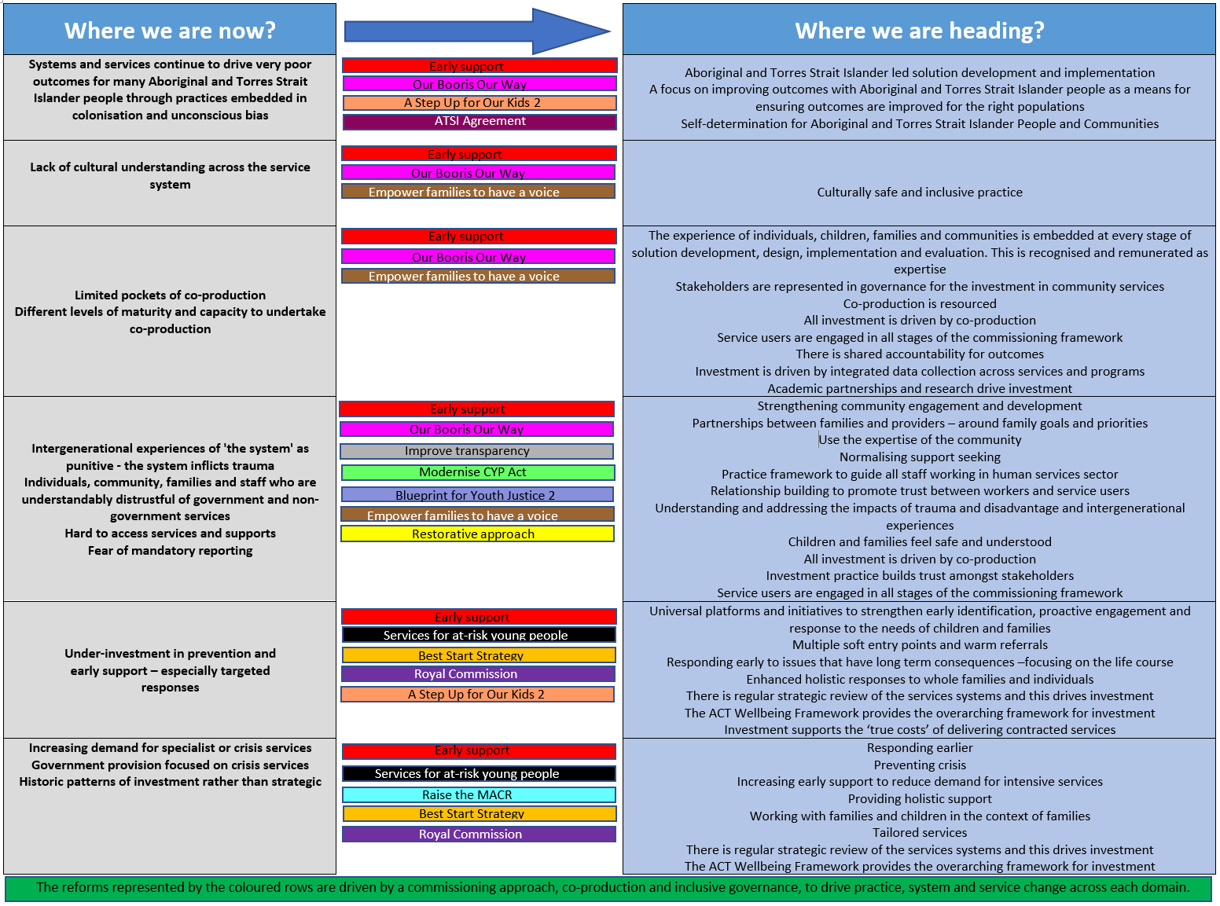
What is the current state and what do we need to address?

Slide 11
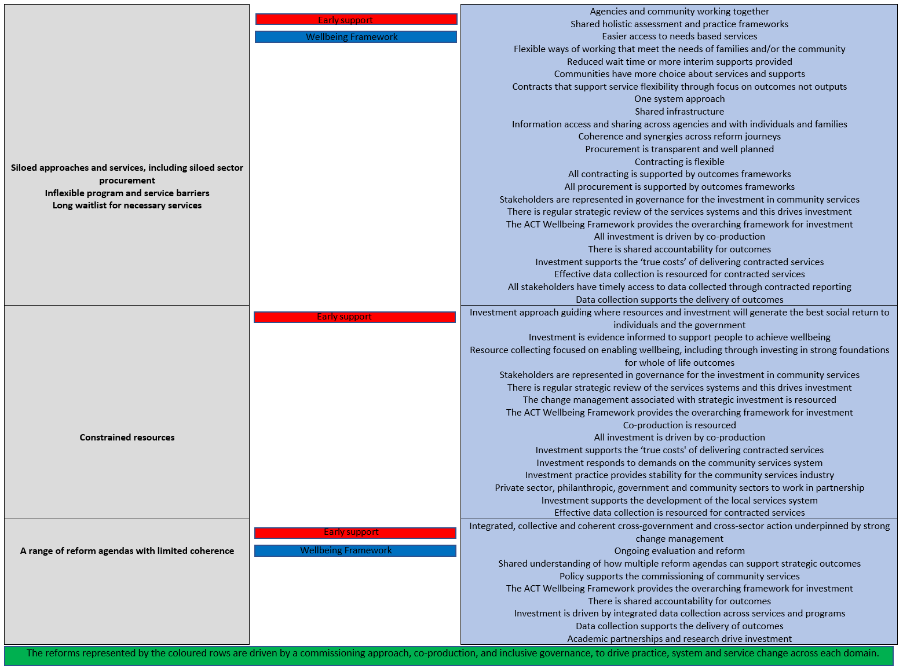
What is the current state and what do we need to address?

Slide 12
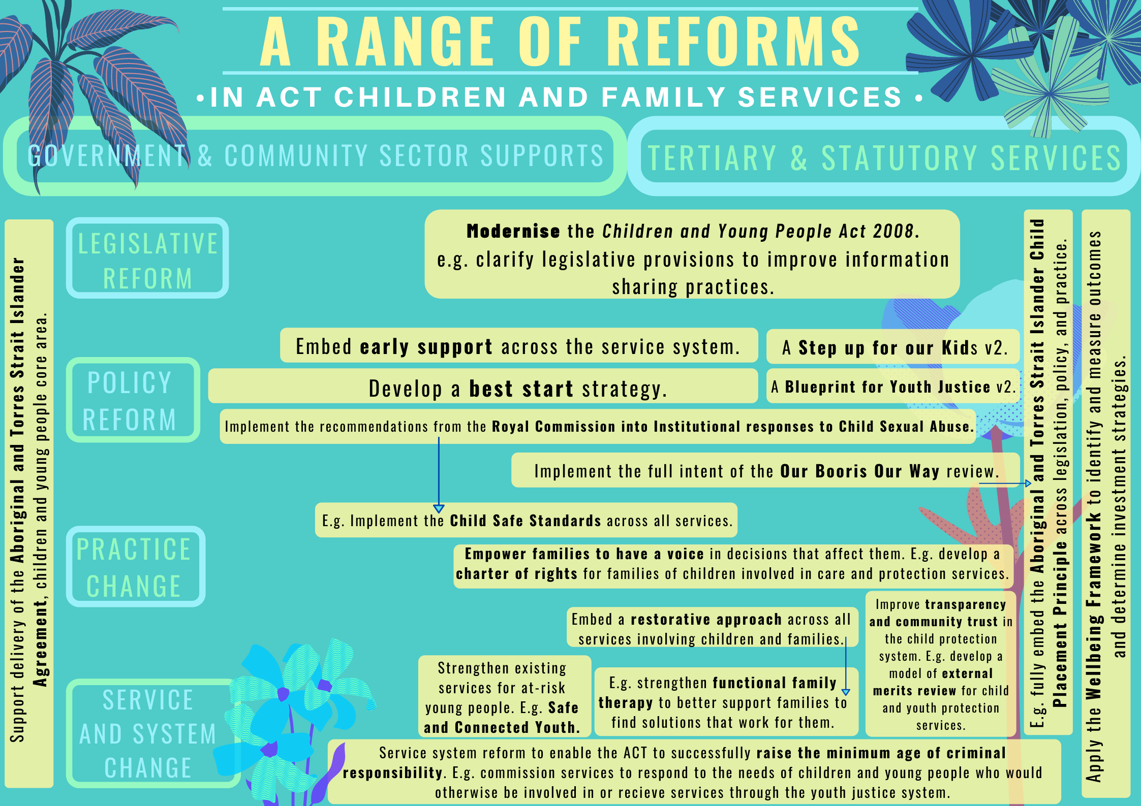

Slide 13
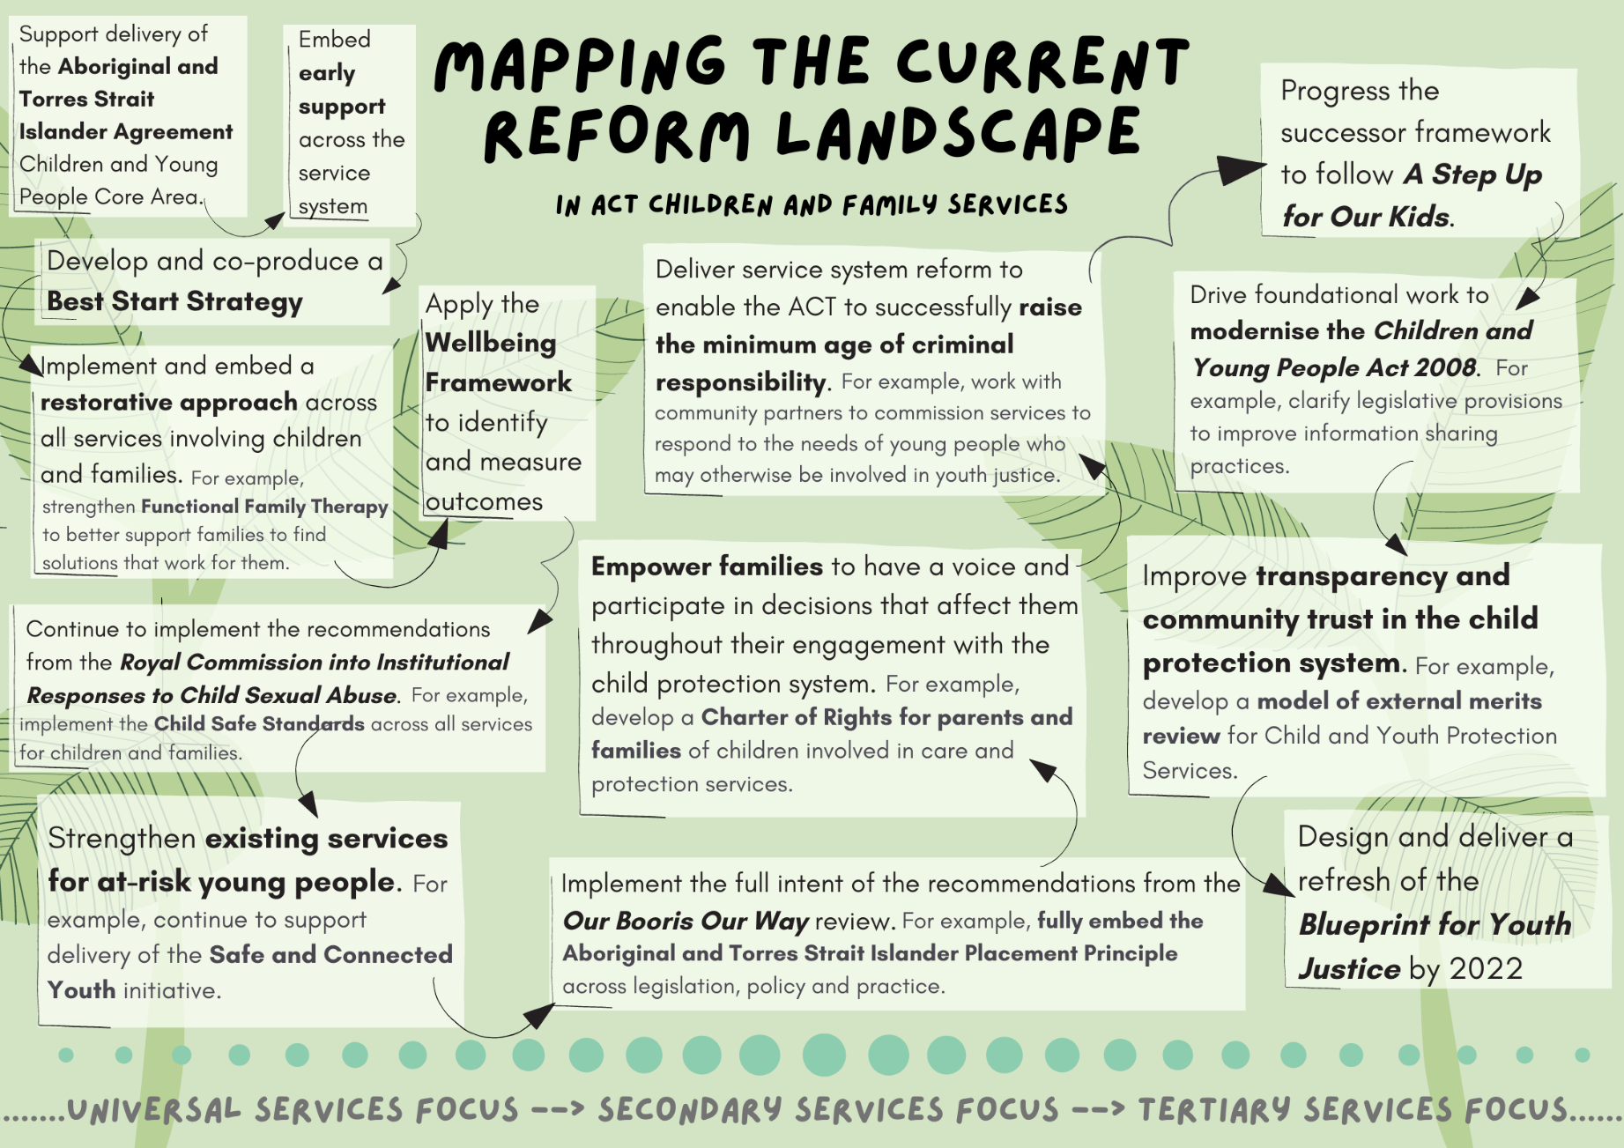
In this complex landscape of reform, where and how can your organisation be involved?

Slide 14
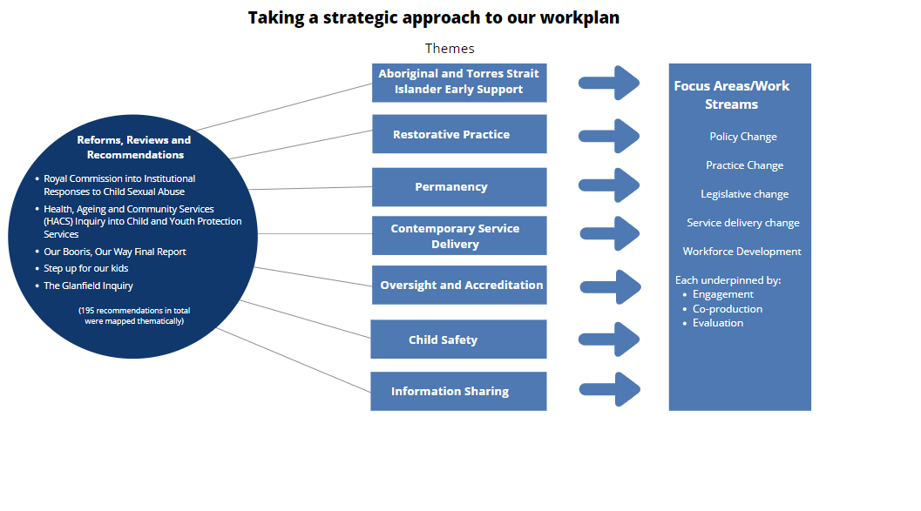
Changing the CYPS system
The ACT Government is currently working to deliver 195 agreed recommendations from a range of reviews, inquiries and reports, including the Royal Commission into Institutional Responses to Child Sexual Abuse and the Our Booris, Our Way review.
These recommendations focus heavily on building a Child and Youth Protection Services system that is restorative, contemporary, underpinned by good decision making, and that puts into practice a holistic understanding of Aboriginal and Torres Strait Islander children, families and communities.

Slide 15
Further detail on key reforms can be found here*
Aboriginal and Torres Strait Islander Agreement 2019-2028
ACT Wellbeing Framework
Safe and Connected Youth
Our Booris, Our Way
A Step up for Our Kids
A Blueprint for Youth Justice (current)
Restorative practice – e.g Functional family therapy
Early Support: Changing Systems, Changing Lives
Best Start for Canberra’s Children: the first 1000 Days Framework
Implement Royal Commission recommendations
Minimum Age of Criminal Responsibility
Modernise the Children and Young People Act
Develop External Merits Review
Charter of rights for parents and families of children involved in the justice system
* As some reforms are early in development, there is limited publicly available background information

