Slide 1

Better Suburbs Forum
Unpacking the Kitchen Table Conversations
Sue Marriage, Project Lead, Better Suburbs
Transport Canberra and City Services

Slide 2
Engagement phases
01
Community survey
Consultation period Sept - Nov 2017
Kitchen Table conversations
02
Consultation period June – July 2018
Citizen’s Forum
03
21 July and August 2018

Slide 3
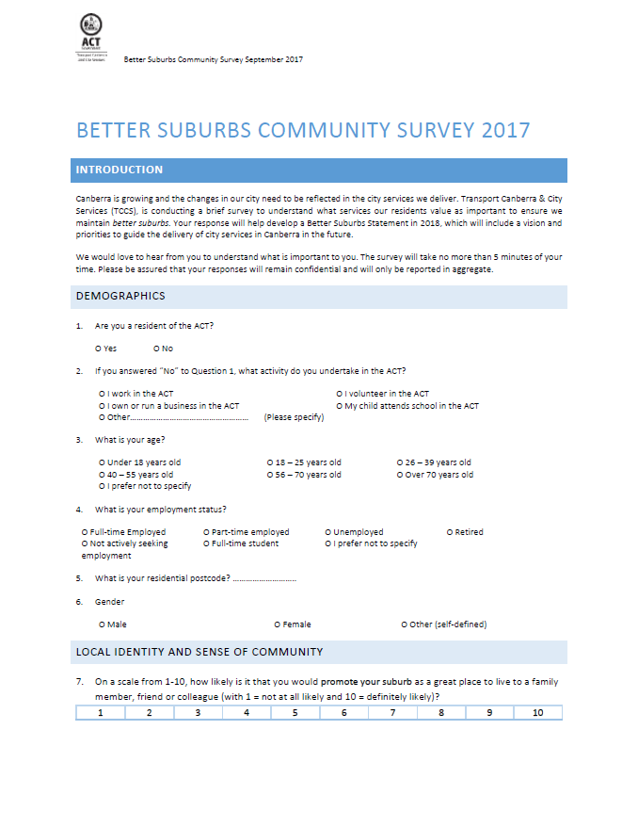
Better Suburbs Survey
The first connection
September to November 2017
Online survey, discussion post and
Calls for Better Practice submissions
1242 responses
Enablers
Total response time – approx 414 hours
Notes:
WHAT WE HEARD

Slide 4
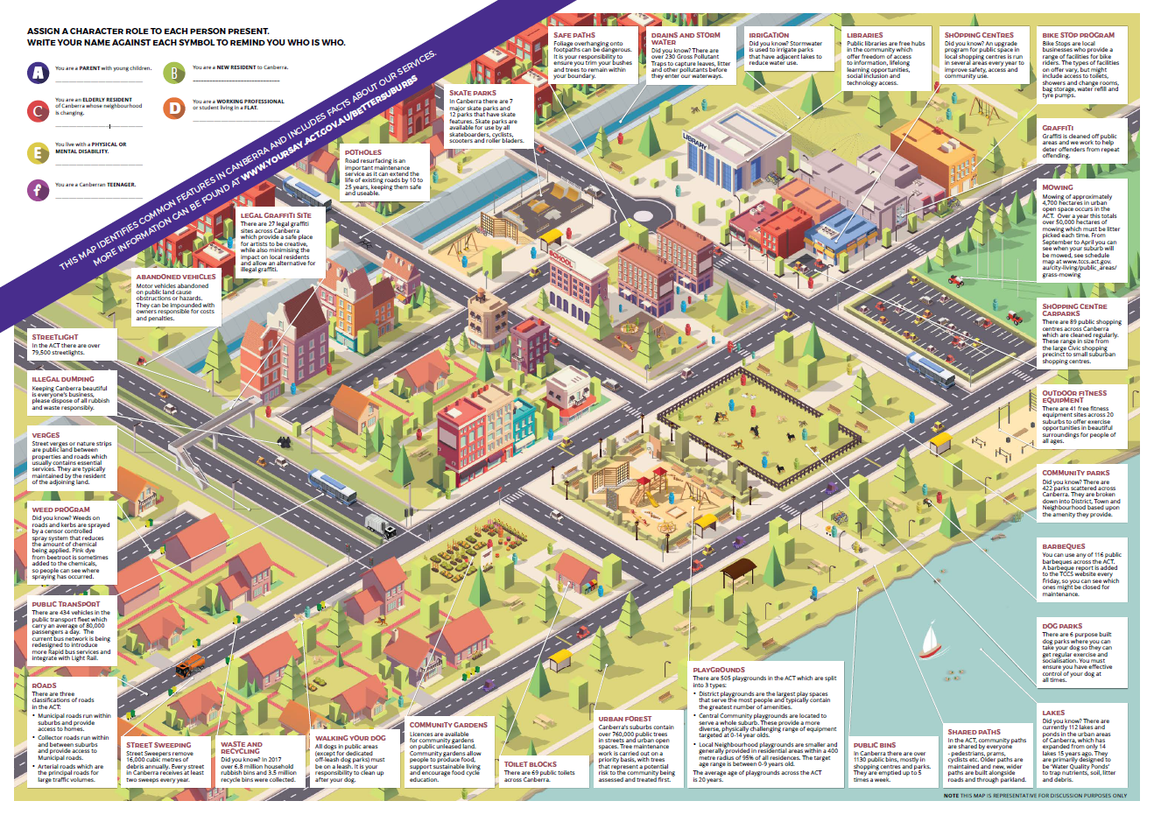
Kitchen Table conversations
Telling our business story for deeper feedback
Total of 6 weeks consultation
Launched 18th June, distributed 25th June
closed 31st July.
Promoted multiple ways
on the buses, on radio, in print, pop-ups, direct contact with stakeholders, on Your Say
Enablers
Deeper community feedback
Group discussion using a journey map and feedback form
More time intensive than a survey
Seeks solutions and ideas in greater detail
Allows stakeholders to have a voice at Forum

Slide 5
Engagement data
Distribution
900 maps and guides released through libraries
279 direct stakeholder emails
54 through MLAs
122 unique page views – Your Say
Interest
Your Say social media
MLA offices, constituent enquiries, media
Categories
Popular 5 features of the group, experiences;
Start, stop and continue to improve experience; opportunity to share responsibility; Better Suburbs Statement content
Enablers
Response
42 responses in total
20 of these are complete

Slide 6
Response groups
Representing community group
Yes - 17.5%
Family discussion
Yes – 55%
Total participants = 184
Age range
From 7 - 82
Response time = 276 hrs
Enablers
Neighbour group
Extended families
Colleague groups
Community organisation that used the characters
Carer’s group
Dog rescue group
Group size
Range from 2 to 22 people, average size 5-6 people
Assigned character role
Yes – 42.5 %

Slide 7
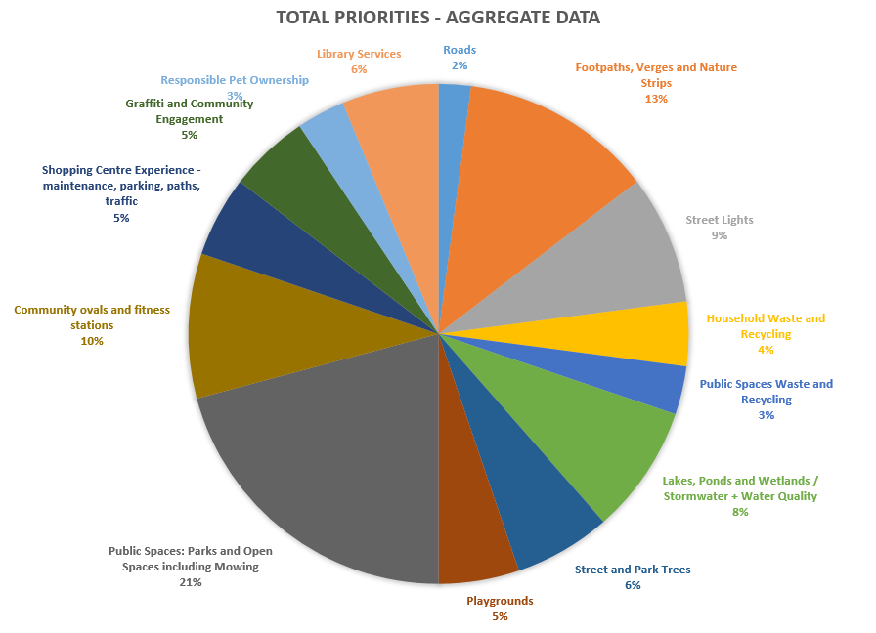
Aggregate group priorities
List the 5 most popular priorities and tell experience
Enablers

Slide 8
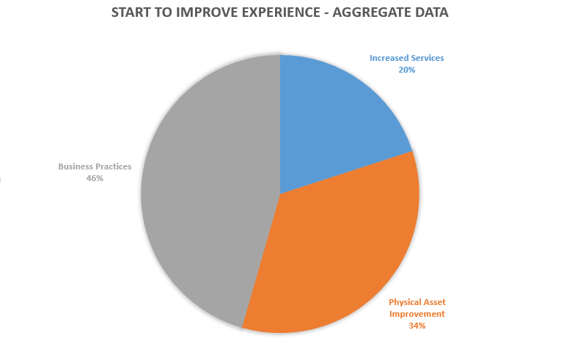
START doing to improve experience
Start, stop and continue doing - feedback
‘Decide if they are to be playground parks or urban forest and design to the target experience. Not every one has to do everything’
“ Stronger focus on reducing
Cars and increasing bikes. Catch up with the other smart cities across the world we see on TV, Facebook and Twitter’
‘more frequent sweeping of the roads to remove leaves, gravel and other debris’
‘ more regular mowing of public ovals during spring time’
‘ wider selection of new books’ (library)
‘ better signage on shared paths used by equestrian’

Slide 9
START doing to improve experience
Streetlights
Install lower level lighting in heavily tree canopy areas
Replace with energy efficient lighting, sensor lighting – multiple
Check street lights regularly and fix faults quicker
Waste
Introduce green waste ASAP, weekly recycle pickup
Dog ownership
Charge more to register dogs and promote better dog care by owners
Roads
More frequent sweeping of roads (multiple)
Explain the pothole program
Traffic calming for anti-rat run
Reduce cars, increase bikes
Libraries
Promote libraries as a community hub. Need cheap meeting rooms
More physical books. Quiet places. Longer opening hours
Renovate, demolish some and improve others.
Partner with businesses, bring back mobile libraries, offer welcome pack for new residents with local info, wider selection of new books
Better locations and accessibility
Shopping experience
Create a more inviting atmosphere; facilitate pop-ups (multiple); facilitate place making events (multiple); more bike parking
Allow proper funds to Town Centre public realm
Graffiti
More legal sites (they are wonderful)
Fix My street should be promoted to get graffiti removed immediately
Have a public art policy that includes wall spaces
Paths and verges
In busy areas, have separate paths for walkers
Better lighting on paths – multiple
Allocate more money to repairs of footpaths and more frequent removal of weeds
Map equestrian trails/shared paths
Keep paths clears of weeds, maybe pave the dirt paths we have all created
Concentrate on walking and cycle paths
Add obvious signs for guiding way (multiple)
Replace damaged paths with wider paths
More accessible lips on paths – they are not
Wider bike paths and make them safer
Stormwater/Lakes and Ponds
Encourage local activity to assist in maintaining stormwater
Build some creek access areas and consider more environmental flows
Build local viewing platforms to expose community to their local waterways
Community ovals
Irrigate school ovals as a backup oval; use treated affluent on ovals; cover seats at ovals to protect from elements
More mowing of public ovals in summer
Open Space (waste/toilets)
Install toilets at regular intervals for convenience of walkers
Provide suitable hoppers in parks
Refurbish toilets and make them accessible. Reopen currently closed toilets or convert to automatic
Use drones to collect waste
Playgrounds
Nice signage at playgrounds (multiple)
Just provide more equipment
Co-locate play spaces with café areas
More interactive equipment for children
Decide if (green space) is to be playground, park or urban forest – not every one has to do everything
Seek input from locals for good ideas for green space in their neighbourhood
Look at other countries to discover youth parks
Urban trees
Give people discounted rates if they maintain their street trees
Allow more flexibility around community removal and replacement of dead/dying trees
Recognise the importance of urban trees and promote it
Speed up the maintenance cycle on street trees
Open space/parks
Put BBQs near playgrounds
Put more money into mowing and weeding, improve parks and ovals by planting grass again
Use autonomous mowers
Speed up the mowing maintenance cycle to keep up
Invest $$$ in mowing program

Slide 10
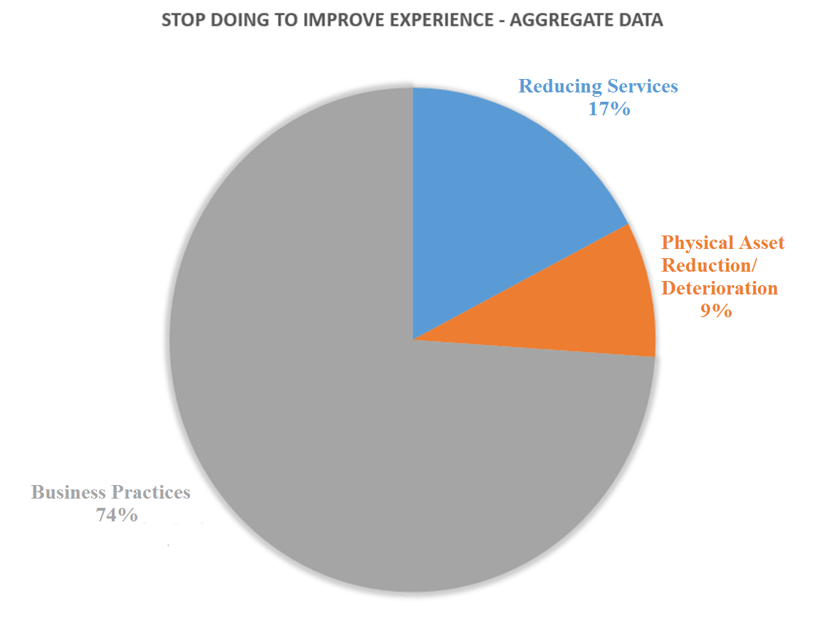
STOP doing to improve experience
Doing to improve our experience
‘Splitting services that could be managed in one Department/ team between many departments/teams’
“ Stop seeing TCCS as a business – instead see it as a foundation for wellbeing of our people and environment’
‘stop cutting library services’
‘cutting the budget for lawn mowing and weeding – labour based activity so efficiencies are limited’
‘ closing toilets’
‘decommissioning BBQs without replacements’

Slide 11
STOP doing to improve experience
Roads
Issuing contracts for fragmented road repair work that is inefficient
Roads in ACT are in excellent condition and could have less spent on them
Resurfacing roads that do not need it. Fill potholes first.
Waste
Ignoring poor recycling practices
Dog ownership
Delivering animal services and work better with other non-profit groups
Stop being soft, give punishment to ongoing offenders
Streetlights
Leaving banks of lights off for too long - unsafe
Shopping experience
Allowing charity harassers outside of shopping centres
Leaving so long between refurbishments
Stormwater/Lakes and Ponds
Trying to slow stormwater down, outside of the catchments
Ignoring the visitor value of our lakes and ponds
Graffiti
Ignoring it!
Paths and verges
Concentrate lighting around ponds and lakes instead of near roads
Allowing developers to install fences that block paths
Building shared paths and bike paths on top of equestrian trails
Resealing paths without good removal of grass in the old path
Stop making paths from asphalt and concrete
Libraries
Cutting library services.
Having so many libraries – less but better
Having libraries that are not located with shops
Community ovals
Wasting water
Automatic watering when sport is on
Open Space (waste/toilets)
Regarding toilets as an expense we can do without
Closing toilets
Playgrounds
Providing poor amenity in some suburbs – equitable
Maintaining old parks in old areas – with old equipment
Assuming all young people like to skate!
Urban trees
Planting gum trees!
The inflexible policy of private tree removal on suburban blocks
Removing trees on public land without replacing them
General
Things are obvious and nothing gets done even after its been lobbied. We pay rates in older suburbs but tend to get overlooked
Stop seeing TCCS as a business – instead see it as foundation for wellbeing of our people and environment
Wasting money on unnecessary things
Having so many things of poor quality – less and better
Focusing on new suburbs only!
Open space/parks
Decommissioning BBQs without replacement (multiple)
Using heavy diesel mowers; cutting the budget for mowing and weeding – aesthetics
Stop mowing areas that could be used for bio-diversity

Slide 12
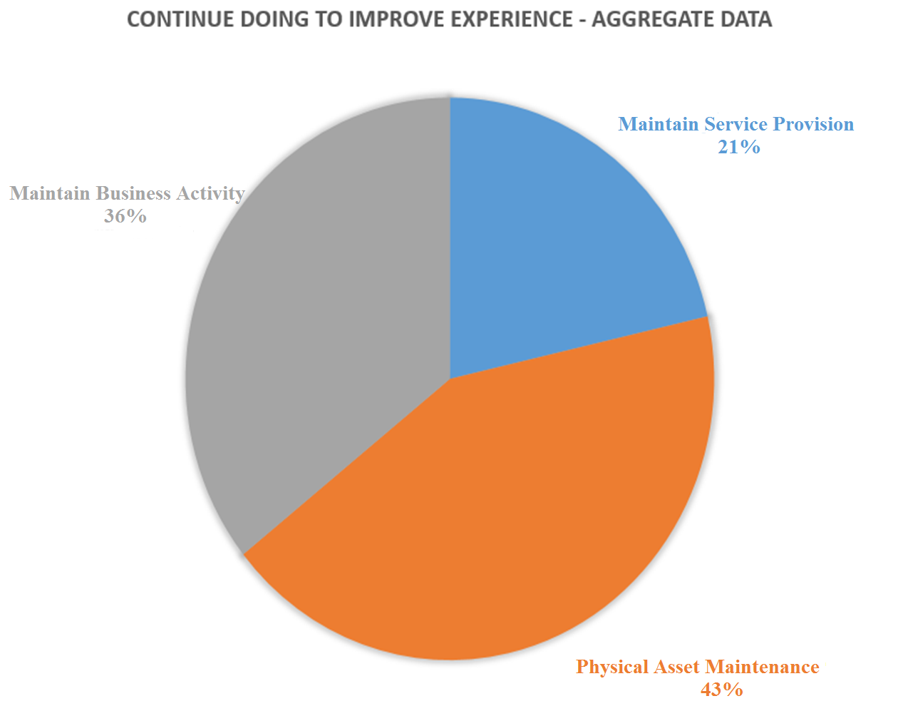
Continue to improve experience
‘The Better Suburbs Survey”
Focusing on the experience you are delivering to the people of Canberra
We are looking forward to our green bins’
‘Cleaning our lake and foreshore’
Supporting our footpath system
Supporting local parks for use by all ages for exercise and walking dogs

Slide 13
Explore to share responsibilities
Education/ share information
Make maps and servicing schedules more readily available in one place
Educate public about responsibility of dogs on leads
Make clear what urban forest maintenance the community is allowed to do on its own
Education program to inform more about recycling
Advice for pruning unleased land
Facilitation
Community meeting about local issues in cafes
Make libraries community hubs for events/activities
Ask library users to suggest new services and acquisitions
Ask people what type of street canopy they want in new suburbs
Sponsor a park program
Consult with children (under 5) and aged to ensure their needs are heard
Ask young people what they want, instead of asking public servants what they can afford
Clean up suburbs campaigns
Ask people, listen and respond – it’s the last item you never do - LISTEN
Community building
Community to help with weeding programs eg Red Hill Regenerators
Involvement in organising and delivering place making events
Volunteering programs in general – groups of interested citizens
Libraries could partner community groups to run activities in and around libraries
Community garden programs
Sponsor a road, pothole to get it fixed – done overseas with great results
Community volunteers could speed up graffiti removal
Explore ideas for co-governance on different programs.
Encourage residents to paint over graffiti tags in their neighbourhood to keep them clean
Reporting
Shopping centre owners to report ‘stray’ shopping trolleys to supermarkets
Notify govt when street lights need to be fixed or installed
More responsibility to community to report street light problems
Notify about graffiti and investigate options for more legal graffiti sites
Display contact details for fault reporting for toilets and BBQ – app?
Notify about weeds overgrown in public places
Facebook or app to report long grass safety issue
Other
Don’t be frightened of what members of community say.
Make the costs of maintenance more visible to people so they are more supportive of TCCS budget

Slide 14
Content of Statement
Suggestions from respondents
Mapping of services by age of infrastructure/ time since last total upgrade
Focus on the basic as well as blue sky
Include section on citizen responsibilities and how this could be set up
Plan for the next generation instead of now
Statement should contain the current problems we face in Canberra, the future changes we are anticipating and the services will be aligned to meet these. We would also like to see a statement of our values as a community written by us so that the government is guided by our priorities, understanding our intent.
Clear commitment to retaining public ownership and full access to public parks and urban forest places. No commercialisation of these spaces
Changes in the demographic of Canberra should be emphasised and therefore change in service mix is needed.
Guiding principles – genuine community democratic commitment – show how progressive and open we are – include an agenda to be forward thinking
We want to share with the Citizen’s Forum the themes that came out in our session.
Social Hubs for different and overlapping community sectors
Safety – shopping centres, paths, toilet blocks, maintain urban forest and shrubs
City and suburban attractiveness
Access – in terms of disability – access to nature, playgrounds, shops, other amenities

Slide 15
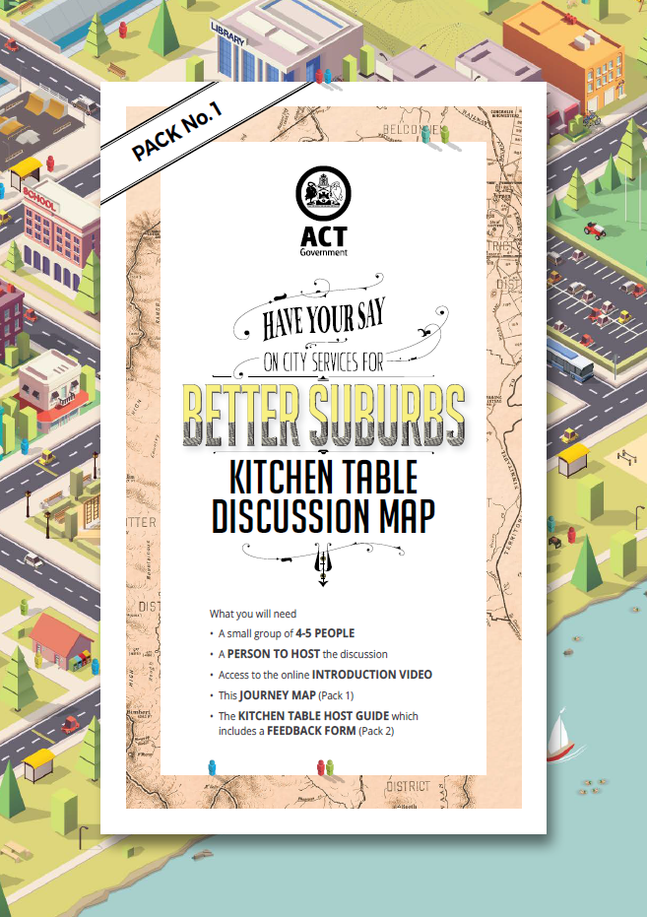
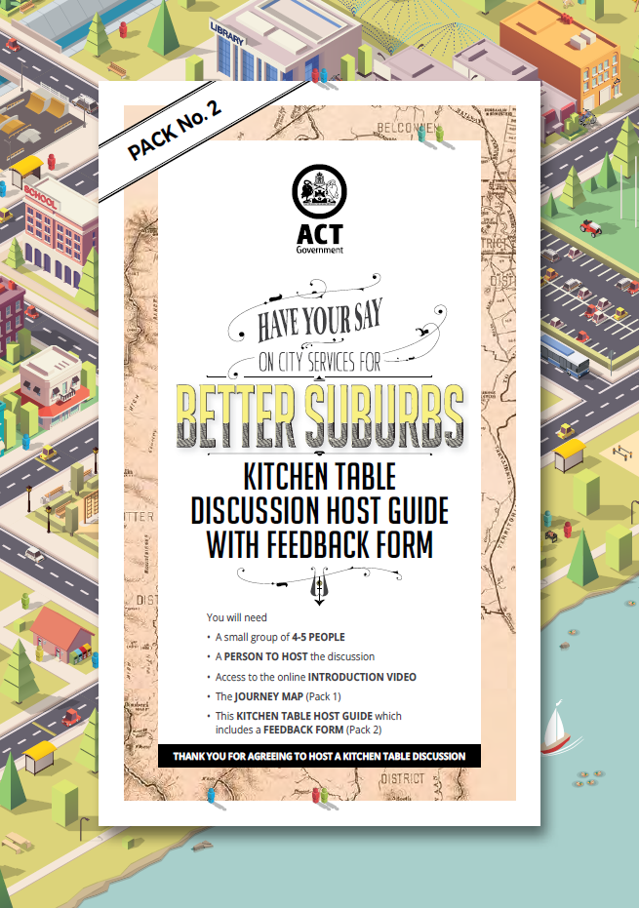
Insights and challenges
Appears to be hesitation in submitting feedback that is a multi-step process and requires a high time commitment
Preparing material in two separate packs is confusing.
Combining an educative tool and feedback tool, may limit our ability to gain clear perspectives of knowledge levels.
Community members expressed some confusion about the purpose of Kitchen Table Conversations (KTCs) within the whole process – need to educate more about process.
Decision-making should be informed by data but consider complexity.
PRIORITISATION
Across all feedback and engagement channels, there have been some consistent priorities.
Other services have been prioritised differently over different feedback channels.
Need to be aware that the services that people are most satisfied with may receive the least calls for priority
Lead the charge - community engagement is not issues management
Notes:
1

Slide 16
Thankyou.

